Slide 1
The Information Theory
C.E. Shannon, ‘A Mathematical Theory of Communication’,
The Bell System Technical Journal, Vol. 27, pp. 379–423, July1948

Slide 2
“If the rate of Information is less
than the Channel capacity then there
exists a coding technique such that
the information can be transmitted
over it with very small probability of
error despite the presence of noise.”

Slide 3
Electrical Communication system
Message (Physical manifestation of INFORMATION) Message
I/P Transducer
O/P Transducer
Electrical signal
Transmitter
Receiver
channel
Twisted Copper wire coaxial cable
optical fiber space

Slide 4
Quantification of the Information associated with a message
Following should be the characteristic features of the information:
    The amount of information (I_{j}) associated with any happening ‘j’ should be inversely proportional to its probability of occurrence.
    I_{jk} = I_{j} + I_{k} ; if events i and j are independent.

Slide 5
Continue….
Shannon proved that the only mathematical function which can retain the previously stated properties of information for a symbol produced by a discrete source is
I_{i} = log(1/P_{i}) bits
The base of log (if 2) define the unit of information (then bits)
A single binary digit (binit) may carry more/less than one bit (may not be integer) information depending upon its source probability.

Slide 6
Average Information
Produced by a source
Usually denoted by H(x) and Ω (p) for binary sources.
It is also named as Source Entropy.
Find H(x) for a discrete source which can produce ‘n’ different symbols in a random fashion.
There is a binary source with symbol probabilities ‘p’ and (1-p). Find the maximum and minimum value of H(x).

Slide 7
H(x) = ∑ x_{i}*P(x_{i}) ; If X is discrete
∫ x*p(x) dx ; If X is continuous.
{H(x)= 1/N(N1*x1+N2*x2+ …….)}
H(x) = Ω (p) = p*log(1/p) + (1-p)*log(1/(1-p))
{can be solved as simple Maxima-Minima problem}
Ω (p)
1
p
0
0.5
1

Slide 8
Entropy of a M-ary source
“A source which generates equally likely symbols will have maximum avg. information”
There is a known mathematical inequality
(V-1) >= log V
equality holds at V=1
Let V = (Qi/Pi) ; such that
∑Qi = ∑Pi =1
( P may be assumed as set of source symbol probabilities and Q is another independent set of probabilities having same number of elements)
v -1
v=1
log(v)

Slide 9
thus, {(Qi/Pi) – 1}>= log (Qi/Pi)
Pi*{(Qi/Pi) – 1}>= Pi* log (Qi/Pi)
∑ Pi*{(Qi/Pi) – 1}>= ∑ Pi* log (Qi/Pi)
{∑ Qi - ∑ Pi } = 0 >= ∑ Pi* log (Qi/Pi)
∑ Pi* log (Qi/Pi) <= 0
Let Qi=1/M (all events are equally likely)
∑ Pi* log (1/M*Pi) <= 0

Slide 10
∑ Pi* log (1/Pi) – log (M) ∑ Pi <=0
H(x) <= log (M)
Equality holds when v=1 i.e. Pi=Qi i.e. P should also be a set of equally likely events.
Conclusion-
“A source which generates equally likely symbols will have maximum avg. information”
“Source coding is done to achieve it”

Slide 11
The entropy: 2nd Law of thermodynamics
The statistical entropy function introduced by Ludwig Boltzmann in 1872: S_{B} = -NK_{B}Σp_{i}.logp_{i}
Shannon said, “Von Neumann told me, ‘You should call it (average information) entropy, for two reasons.
  In the first place your uncertainty function has been used in statistical mechanics under that name, so it already has a name.
  In the second place, and more important, nobody knows what entropy really is, so in a debate you will always have the advantage.”
German physicist Rudolf Clausius coined the term ENTROPY. On April 24th 1856, he stated the best-known phrasing of the second law of thermodynamics:
The entropy of the universe tends to a maximum.

Slide 12
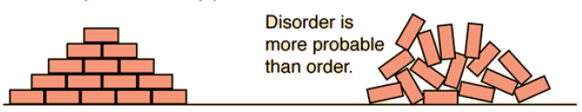
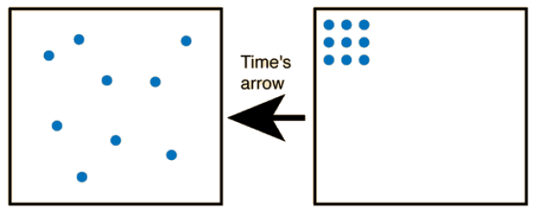
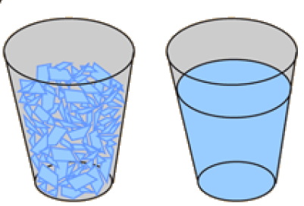

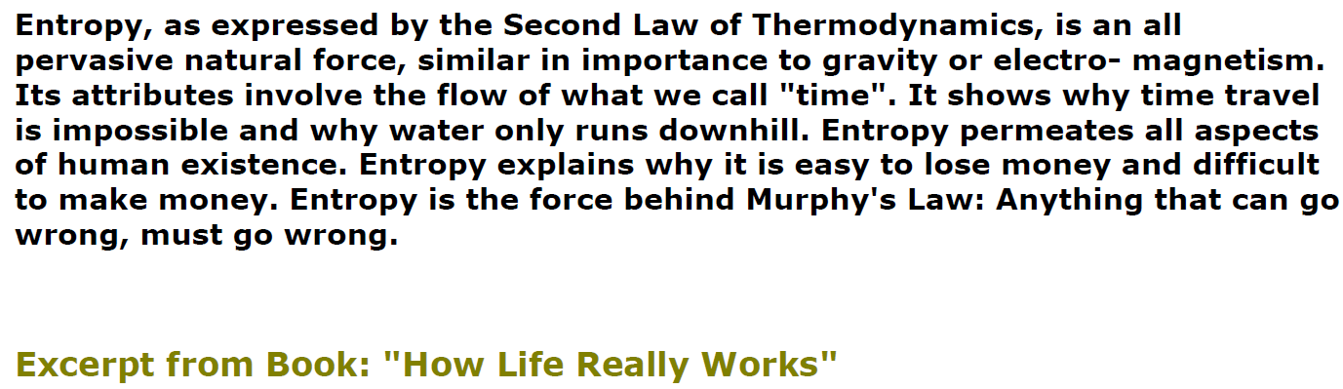
http://hyperphysics.phy-astr.gsu.edu/hbase/therm/entrop.html

Slide 13
Coding for Memoryless source
Generally the information source is not of designers choice thus source coding is done such that it appears equally likely to the channel.
Coding should neither generate nor destroy any information produced by the source i.e. the rate of information at I/P and O/P of a source coder should be same.

Slide 14
Rate of Information
If the rate of symbol generation of a source, with entropy H(x), is r symbols/sec. then
R = r*H(x) and R<= r*log (M)
If a binary encoder is used then
o/p rate = r_{b}* Ω (p) and <= r_{b}
(if the 0’s and 1’s are equally likely in coded seq)
Thus as per basic principle of coding theory
R {= r*H(x)} <= r_{b} ; H(x) <= r_{b}/r ; H(x)<= N
Code efficiency = H(x)/N <=100%

Slide 15
Uniquely Decipherability (Kraft’s inequality)
A source can produce four symbols
{A(1/2, 0); B(1/4, 1); C(1/8, 10); D(1/8, 11)}.
[symbol (probability, code)]
Then H(x)= 1.75 and N = 1.25 so efficiency > 1
where is the problem?
Kraft’s inequality
K = ∑2 ^{-Ni} <= 1

Slide 16
Source coding algorithms
Comma code
(each word will start with ‘0’ and one extra ‘1’ at the end. first code = 0)
Tree code
(no code word appears as prefix in another codeword, first code = 0)
Shannon – Fano
( Bi partitioning till last two elements. ‘0’ in upper/lower part and ‘1’ in lower/upper part)
Huffman
(adding two least symbol probabilities and rearrangement till two elements, back tracing for code.)
n^{th} extension
(form a group by combining ‘n’ consecutive symbols then code it.)
Lempel – Ziv
(Table formation for compressing binary data)

Slide 17
Source Coding Theorem
H(x)<=N< H(x) + φ ; φ should be very small.
Proof:
It is known that ∑ Pi* log (Qi/Pi) <= 0
As per Kraft’s inequality 1 = (1/K)∑2 ^{-Ni} , thus it can be assumed that Qi = 2^{-Ni}/K (so that addition of all Qi =1).
Thus, ∑ Pi*{log(1/Pi) – Ni – log (K)} <=0
H(x) – N – log (K)<=0; H(x)<= N + log (K)
since log (K)<=0 (as 0<K<=1) thus H(x)<=N
For optimum codes K=1 and Pi=Qi

Slide 18
Symbol Probability Vs code length
We know that an optimum code requires K=1 and Pi=Qi
Thus, Pi = Qi = 2^{-Ni}/K(=1) thus Ni = log(1/Pi)
Ni = Ii
(the length of code should be (inversely) proportional to its information (probability))
Samuel Morse applied this principle long before Shannon has mathematically proved it

Slide 19
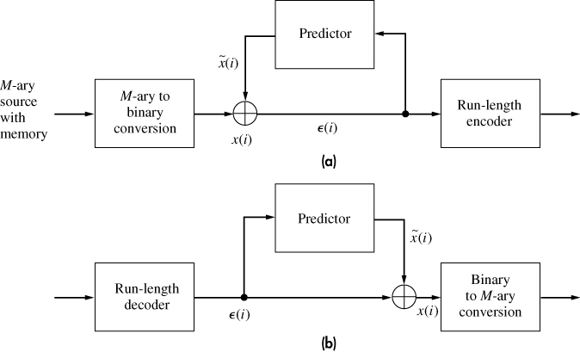
Predictive run encoding
n | Encoding | Decoding
0 | 00…00(k) | 1
1 | 00…01 | 01
2 | 00...10 | 001
- | - | -
- | - | -
m-1 | 11…10 | 00..01
>=m | 11…11 | 00..00 (m)
‘run of n’ means ‘n’ successive 0’s followed by a 1.
m = 2^{k}-1
k-digit binary codeword is sent in place of a ‘run of n’ such that 0<=n<=m-1

Slide 20
Designing parameters
A run of n has total n+1 bits. If ‘p’ is the probability of correct prediction by the predictor then the probability of a run of n is P(n)= p^{n}*(1-p).
E[n] = E = ∑(n+1)*P(n); (for 0<=n<=infinity) = 1/(1-p)
The series (1-v)⁻²=1+2v+3v²+------; for v²<1 is used.
If n>m such that (L-1)*m<=n<=L*m – 1 then number of codeword bits required to represent it will be N=L*k
Write an expression for avg. no. of code digits per run.

Slide 21
N = k* ∑P(n);0<=n<=(m-1)
+2k*∑ P(n);(m-1)<=n<=(2m-1)
+3k*∑ P(n);(m-1)<=n<=(2m-1) +…….
It can be solved to N = k/(1-p^{m})⁻²
There is an optimal value of k which minimizes N for a given predictor.
N/E = r_{b}/r; measures the compression ratio. It should be as low as possible.

Slide 22
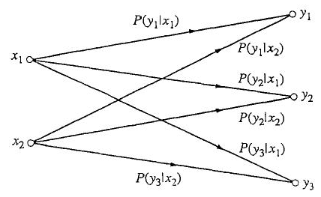
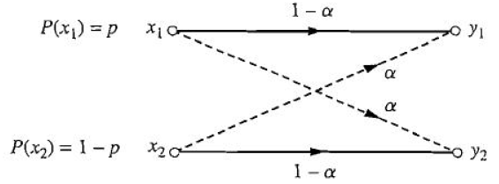
Discrete Channel Models
Binary Erasure Channel (BEC)
2 source and 3 receiver symbols.
(two threshold detection)
Binary Symmetric Channel (BSC)
2 source and 2 receiver symbols.
(single threshold detection)
Mutual information measures the amount of information transferred when x_{i} is transmitted and y_{j} is received

Slide 23
Discrete channel analysis
P(x_{i}); Probability that the source selects symbol x_{i} for Tx.
P(y_{j}); Probability that symbol y_{j} is received.
P(y_{j}|x_{i}) is called forward transition probability.
Mutual information measures the amount of information transferred when x_{i} is transmitted and y_{j} is received.

Slide 24
Mutual Information (MI)
If we happen to have an ideal noiseless channel then definitely each y_{j} uniquely identifies a particular x_{i}; then P(x_{i}|y_{j})=1 and MI is expected to be equal to self information of x_{i}.
On the other hand if channel noise has such a large effect that y_{j} is totally unrelated to x_{i} then P(x_{i}|y_{j})=P(x_{i}) and MI is expected to be zero.
All real channels falls between these two extremes.
Shannon suggested following expression for MI which does satisfy both the above conditions
I(x_{i};y_{j}) = log {P(x_{i}|y_{j}) / P(x_{i})} bits

Slide 25




I(X;Y) = ∑ P(xi,yj)*I(xi;yj); (for all possible values of i and j)
Discuss the physical significance of H(X/Y) and H(Y/X)

Slide 26
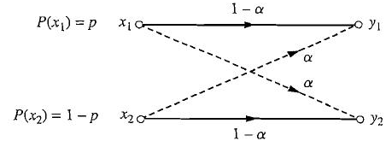
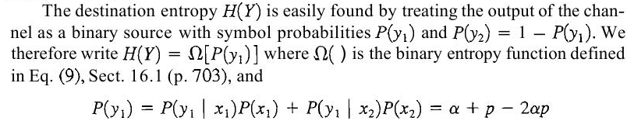
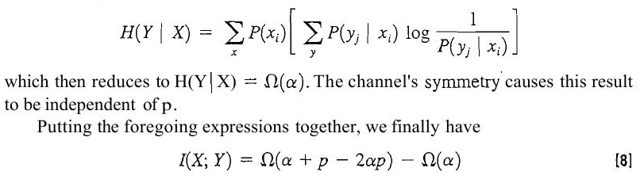
Mutual information of BSC

Slide 27
Discrete Channel Capacity
Discrete Channel Capacity (C_{s}) = max I(X;Y)
If ‘s’ symbols/sec is the maximum symbol rate allowed by the channel then channel capacity (C) = s*C_{s} bits/sec i.e. maximum rate of information transfer.
Shannon’s Fundamental theorem
“If R<C, then there exists a coding technique such that the O/P of a source can be transmitted over the channel with an arbitrarily small frequency of errors.”

Slide 28
The general proof of theorem is well beyond the scope of this course but following cases may be considered to make it plausible –
(a) Ideal Noiseless Channel
Let the source generates m=2^{k} symbols then
C_{s}= max I(X;Y)= max H(x) = log(m)= k and C = s*k.
Errorless transmission rests on the fact that the channel itself is noiseless.
In accordance with coding principle, the rate of information generated by binary encoder should be equal to the rate of information over the channel (if source would be connected directly to the channel)
Ω(p)*r_{b} = r*H(X) on taking maximum of both sides r_{b}= s*k = C
We have already proved that r_{b}>=R otherwise it will violate Kraft’s inequality thus C>=R

Slide 29
(b) Binary Symmetric Channel
I (X;Y) = Ω(α + p - 2*p*α) - Ω(α); Ω(α) being constant for a given α.
Ω(α + p - 2*p*α) varies with source probability p and reaches a maximum value of unity at (α+p - 2*p*α)=1/2.
Ω(α + p - 2*p*α) =1 if p=1/2; irrespective of α
It is already proved that Ω(1/2)=1 is the maximum.

Slide 30
Using an optimum source coding technique p=1/2 can be achieved.
Thus Cs = max I(X;Y) = 1- Ω(α) and C=s*{1- Ω(α)}.
C decreases to zero and again it increases to one, as alpha varies from 0 to 1.
C
Ω (α)
1
1
0
0
0.5
1
α
0.5
1
α
Fig.2
Fig.1

Slide 31
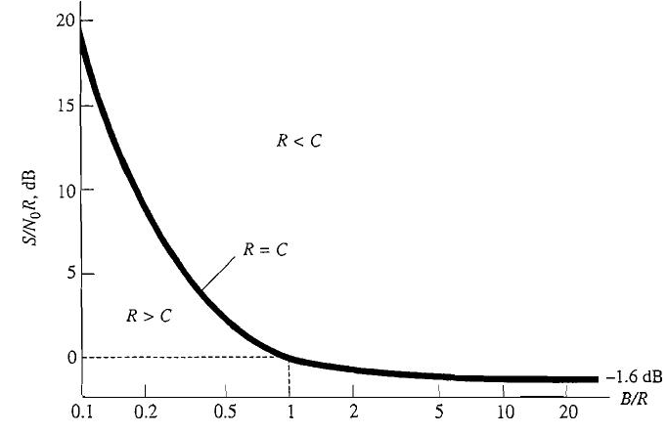




Hartley-Shannon Law
C= B*log(1+S/N)
The bandwidth compression (B/R<1) requires a drastic increase of signal power.
What will be the capacity of an infinite bandwidth channel?
Find minimum required value of S/N₀R for bandwidth expansion(B/R>1)

